Slide 1

IT Introduction

Slide 2

Introduction to IT
APAC IT Organization
Intranet&Network
Standard Software & Application
Jira IT Ticket System
Register Multi-factor authentication (MFA)
Cisco AnyConnect VPN
Network Driver
How to Add a Printer
Outlook backup&Online version overview
Book Meeting Room
Teams Channels
Basic IT Policy in Jula
Q&A

Slide 3
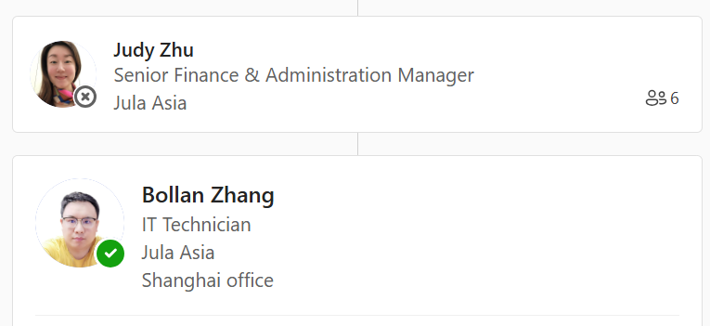
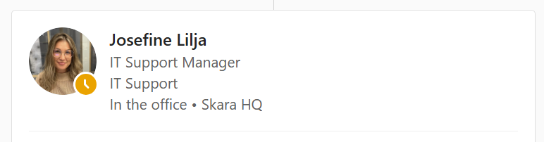
APAC IT Organization
Jula APAC IT Team

Slide 4
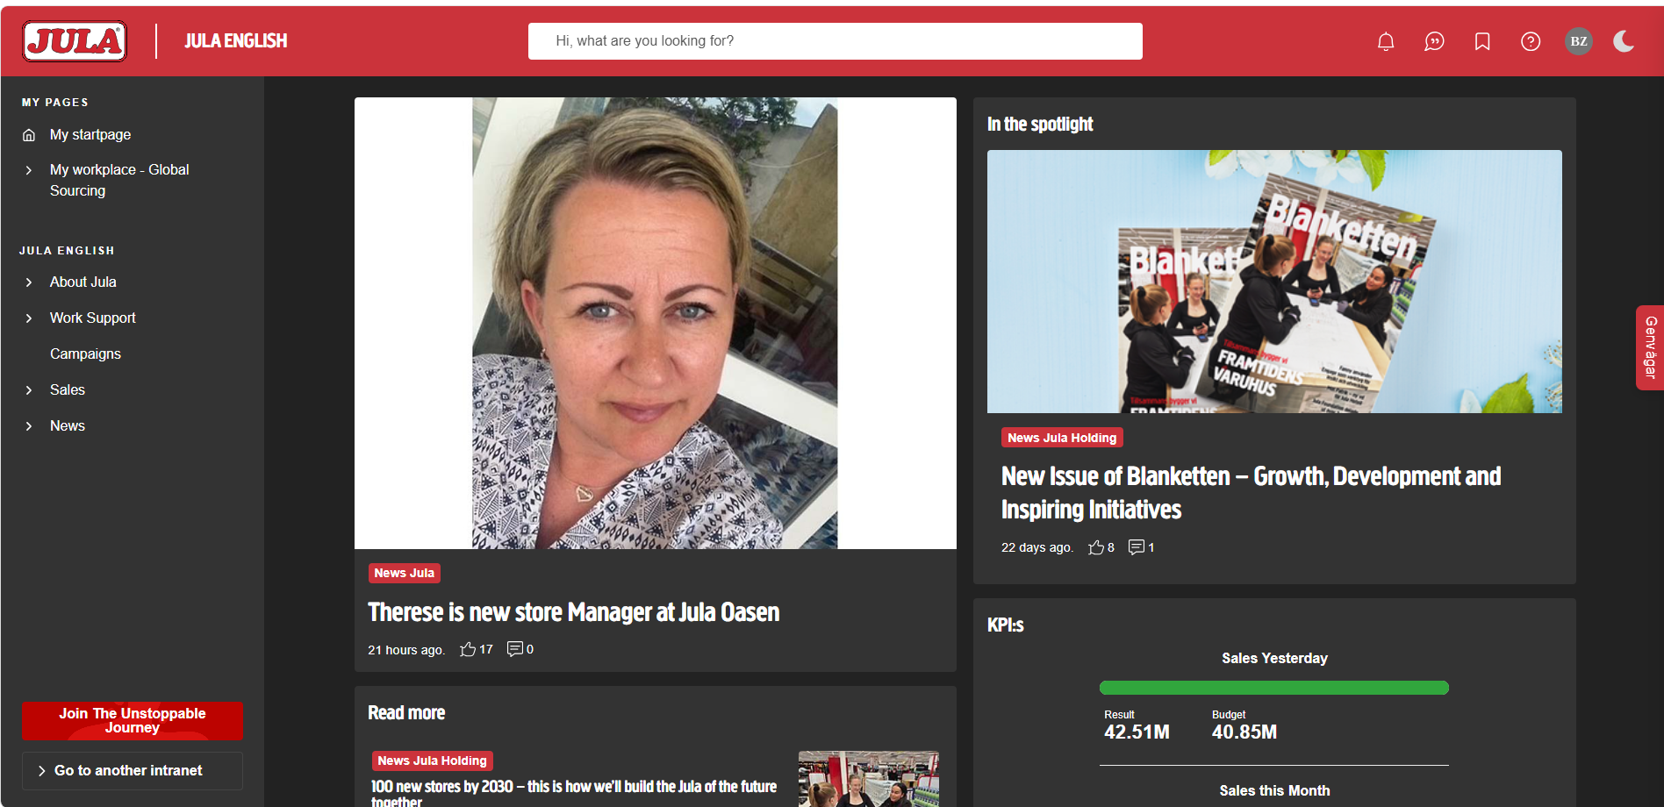
Intranet&Network
Intranet
https://intranet.julaholding.com/
Network SSID
Shanghai Office
WIFI SSID 内网: hk_wlan
PW: sPeXa7U4As
WIFI: Jula Asia_1/Jula Asia_2/Jula_Asia-902-1
PW: @siA0801
Ningbo Office
WIFI SSID 内网：Jula-Employee
PW：Julanb2017
WIFI SSID：Jula_Guest/Jula_Guest-5G
PW：@siA0801
Guangzhou Office
WIFI SSID 内网：JulaGZ
PW：Jula@202110
WIFI SSID：Jula Employee-5G/JulaEmployee
PW：JulaGZoffice

Slide 5



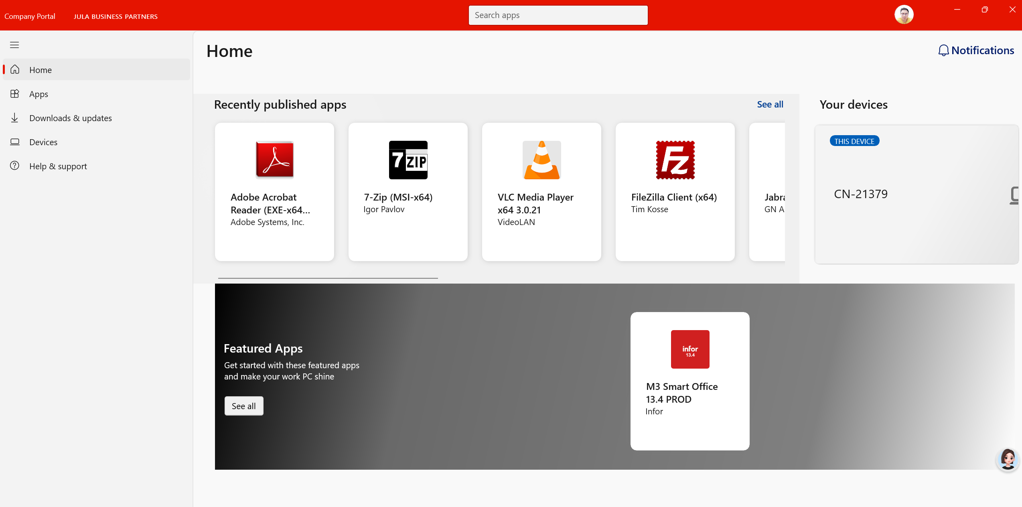


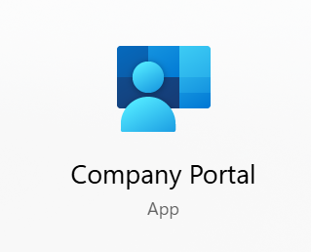
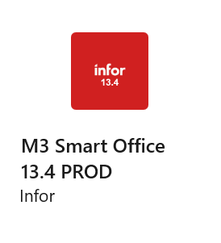

Standard Software & Application

Slide 6
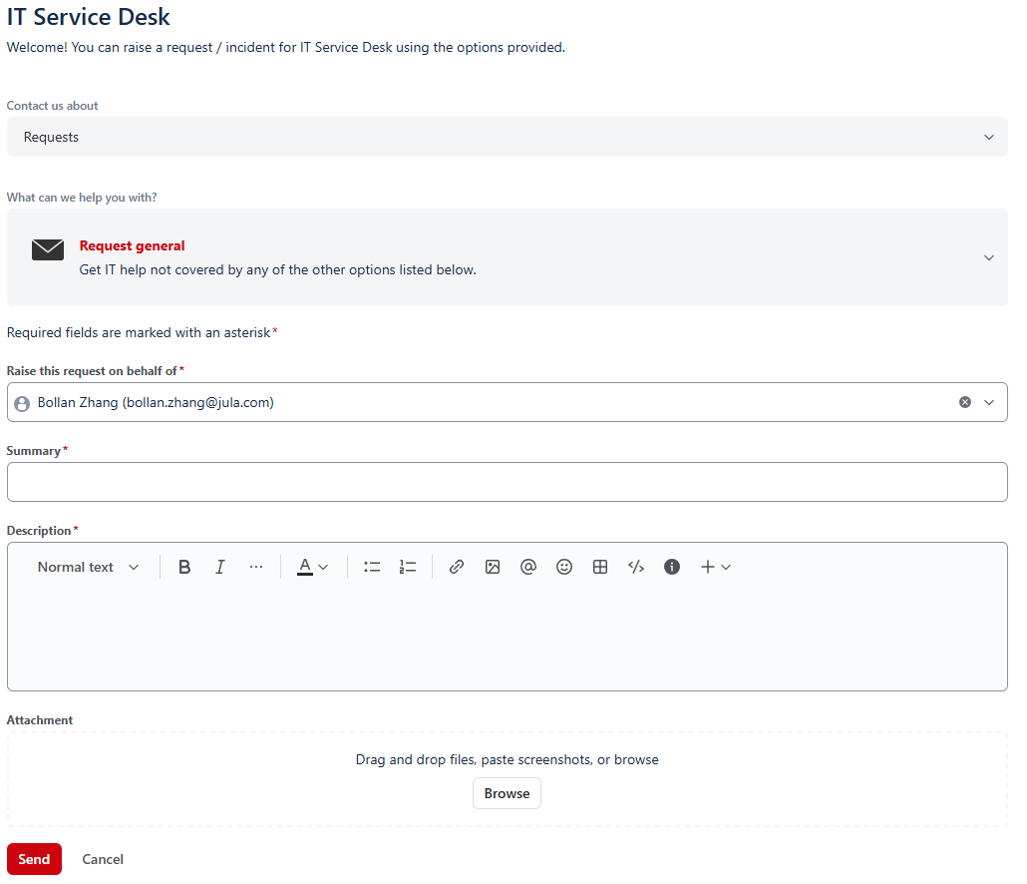
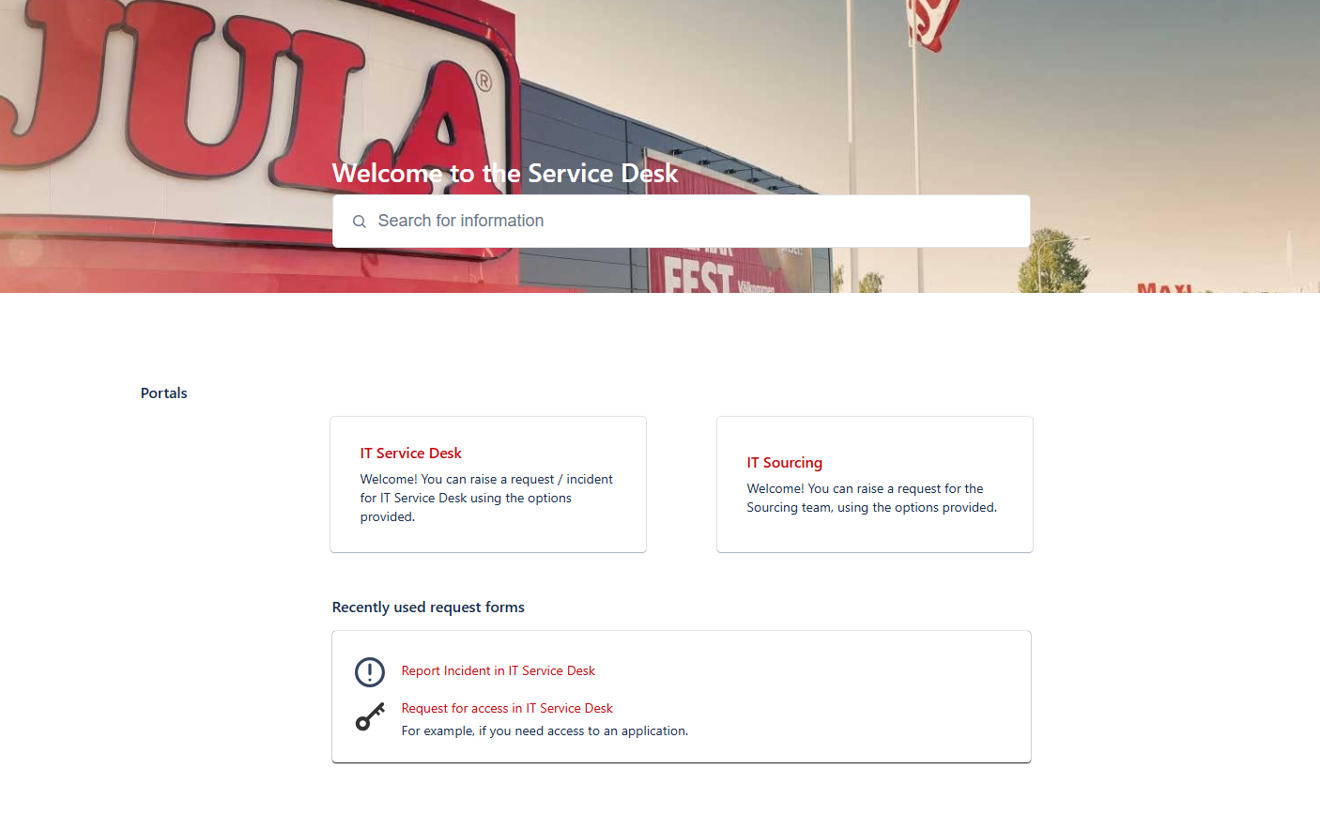
Jira IT Ticket System
If you have any IT issues, you can submit a Ticket^_^
https://jula.atlassian.net/servicedesk/customer/portals
Submit the ticket in the IT Service Desk system
IT Ticket System SOP 1.0.pdf
Footer text

Slide 7
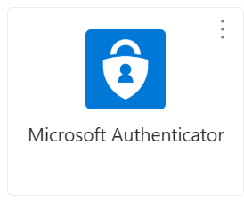
Register Multi-factor authentication (MFA)
MFA Registration & Authentication：
Register Multi-factor authentication (MFA)
MFA手机短信认证 (China Android mobile phone only)
Company Portal Intune Enrollment：
安卓手机安装公司门户 (China Android mobile phone only)

Slide 8
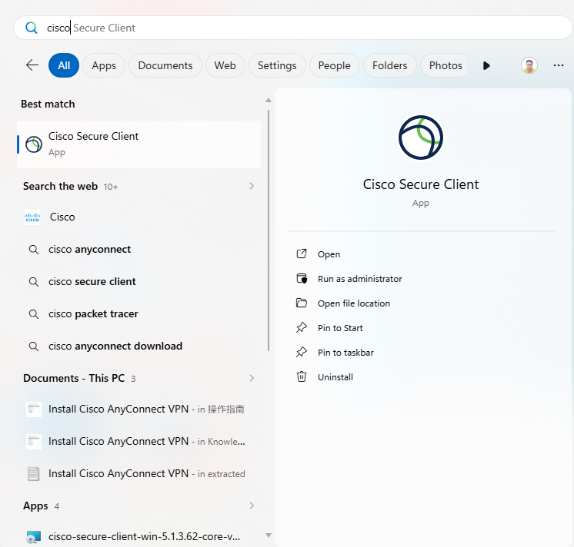
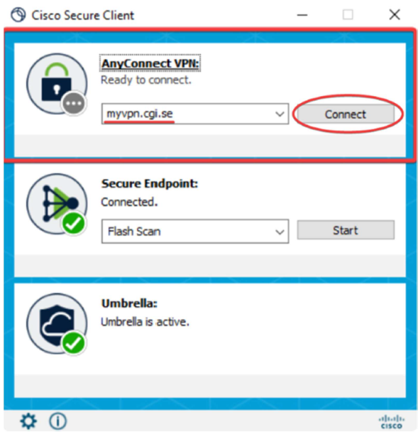
Cisco AnyConnect VPN
When connected to an external network, VPN is required to access corporate web resources.
Install Cisco AnyConnect VPN
Search for Cisco Secure Client and open it
To connect using AnyConnect VPN, enter myvpn.cgi.se and click Connect
Password is the Authenticator application code + your PIN-code

Slide 9
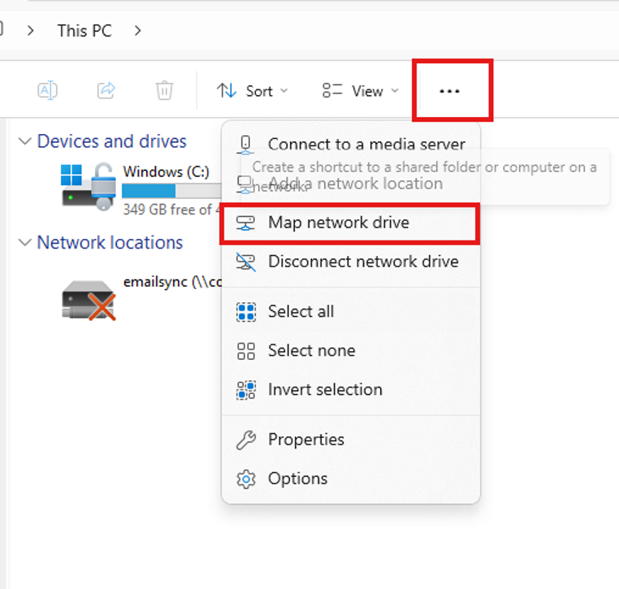
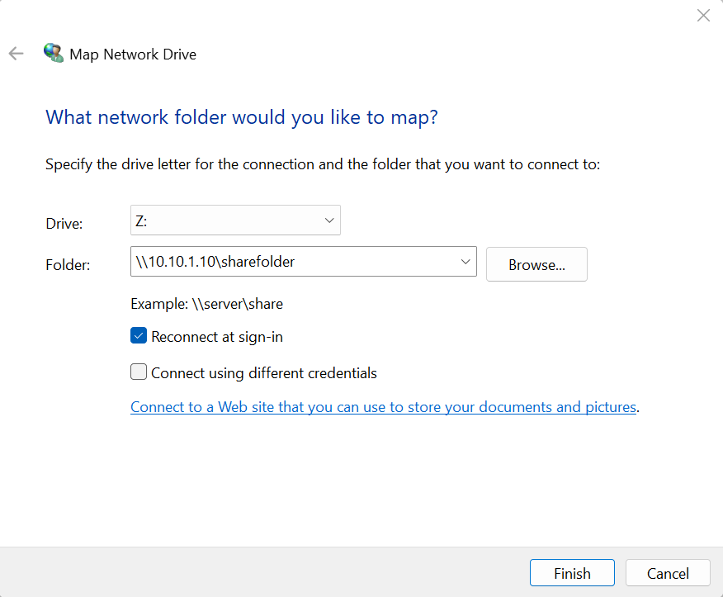
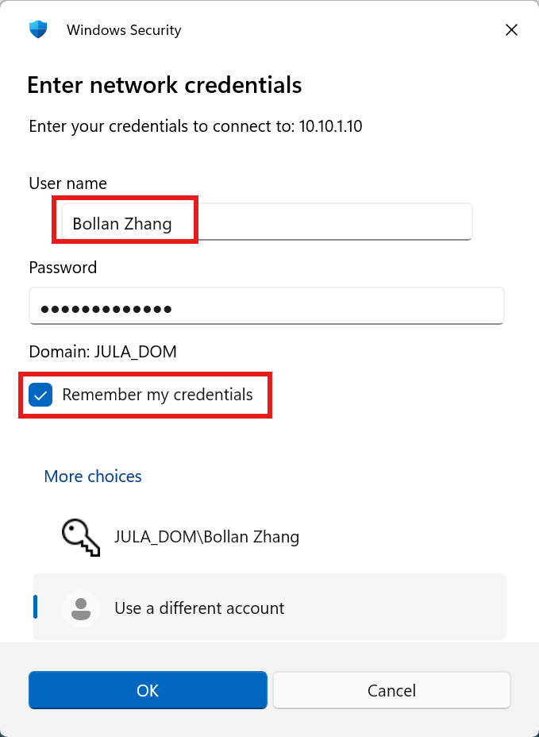
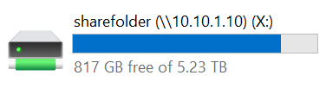
Network Driver
Method for adding is as follows:This PC > Open… Select Map network drive
In the dialog box, select a drive letter for Drive, enter “\\10.10.1.10\sharefolder” in the Folder field, check the first checkbox below, and click Finish.
You will be prompted to enter username and password. Please select Use a different account, then input your credentials to log in.
Note: The NAS network disk uses an independent set of account and password, which is different from your email account credentials. If you do not know them, please contact IT for a password reset.
Once added successfully, it will show up in This PC.
Shanghai NAS
\\10.10.1.10\sharefolder
Ningbo NAS
\\10.10.3.190\photoshop

Slide 10
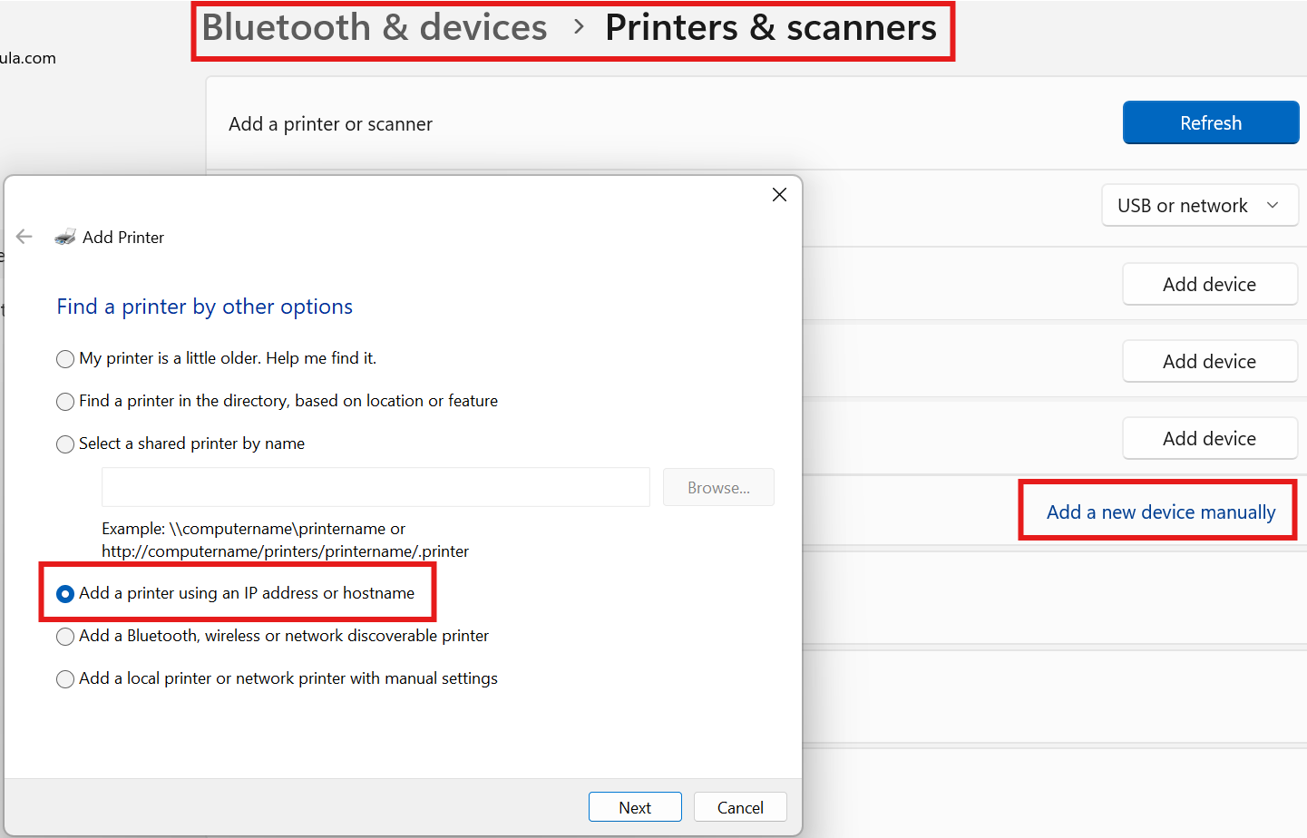
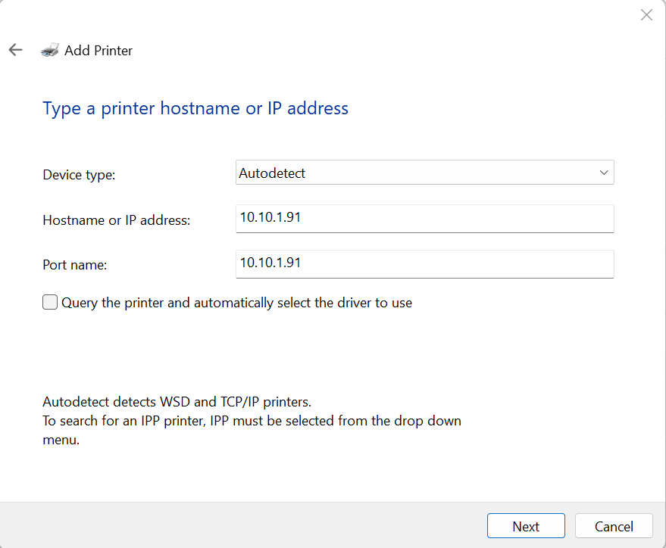
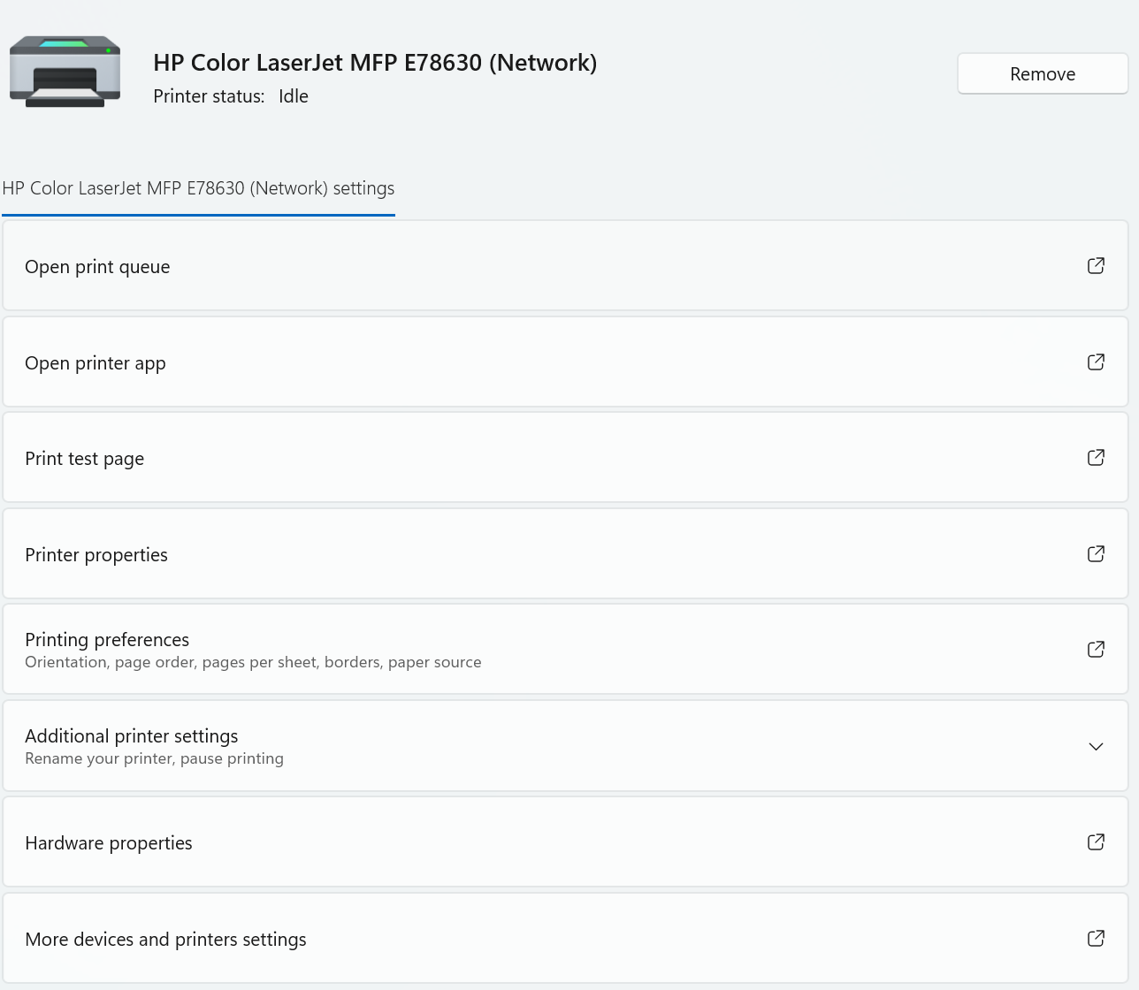
How to Add a Printer
Once the printer installation completes and the HP printer appears, it indicates that the addition was successful. Modify the default black‑and‑white print settings as follows. Remember to select the name of the newly added printer when printing documents.
Add Shanghai Office Printer: 10.10.1.91
Settings > Bluetooth & devices > Printers & scanners > Add device, select Add a new device manually
Select Autodetect and enter IP address 10.10.1.91.
If it is not detected automatically, select IPP Device.

Slide 11
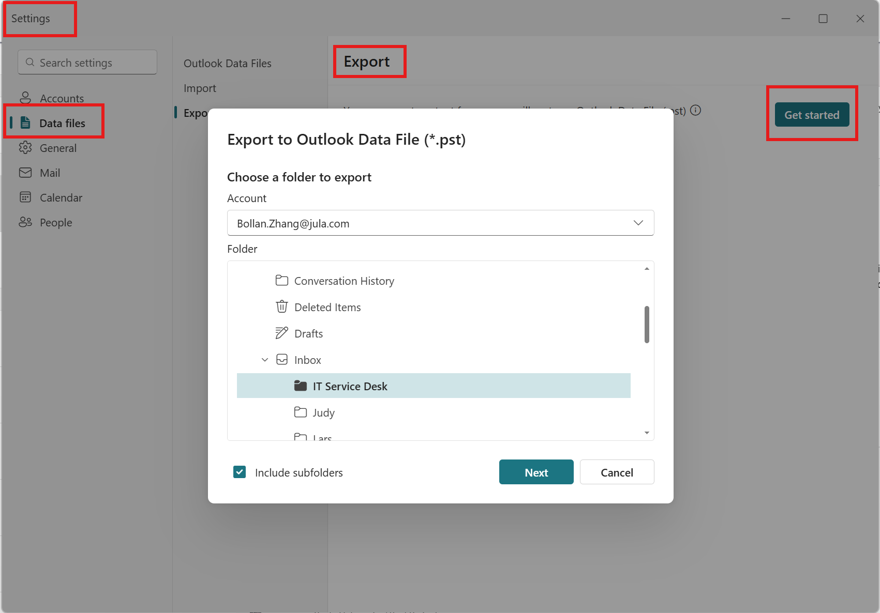
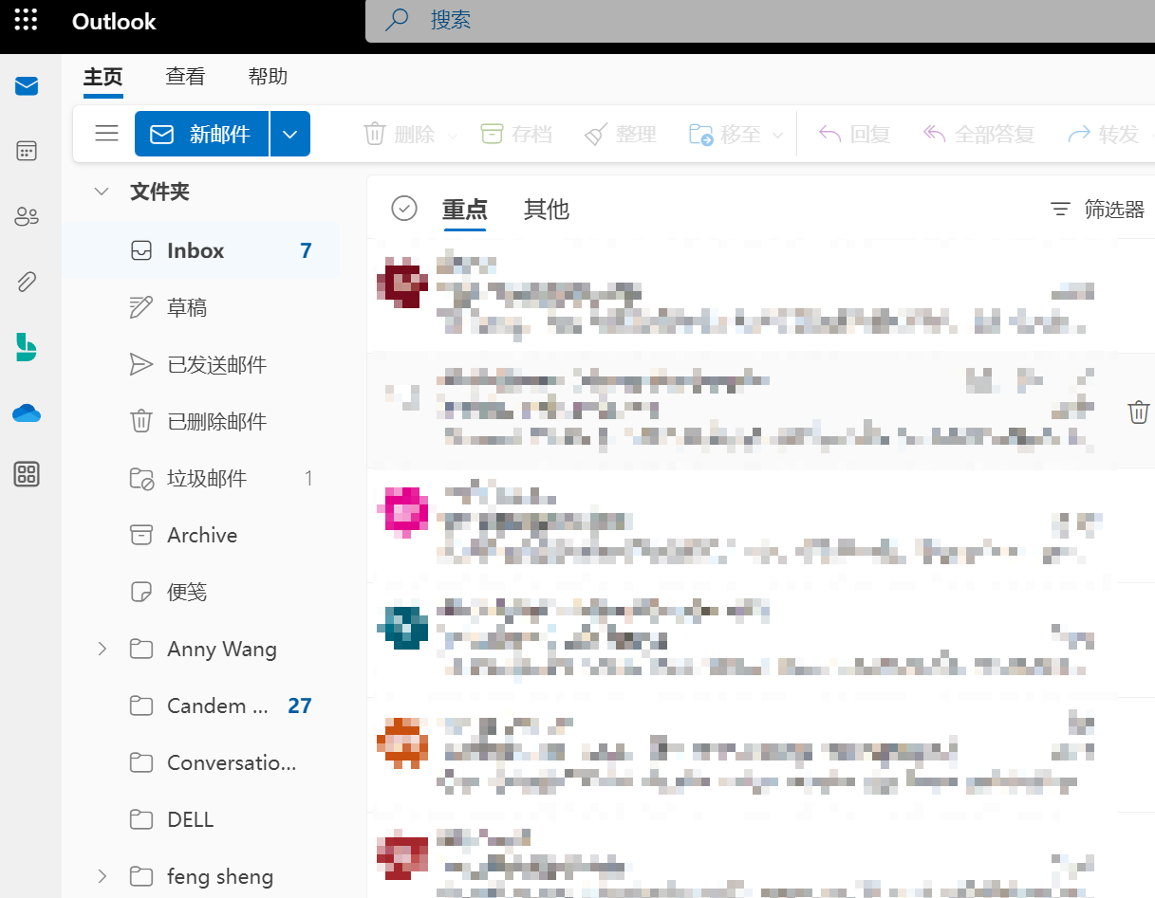
Outlook backup&Online version overview
Outlook backup .pst file: Settings>Data Files>Export
If you perform an Outlook backup to a .pst file, make sure to back up this file before switching to a new PC or reinstalling the system. Otherwise, historical emails will be lost.
Online version:
https://outlook.office365.com/mail/

Slide 12
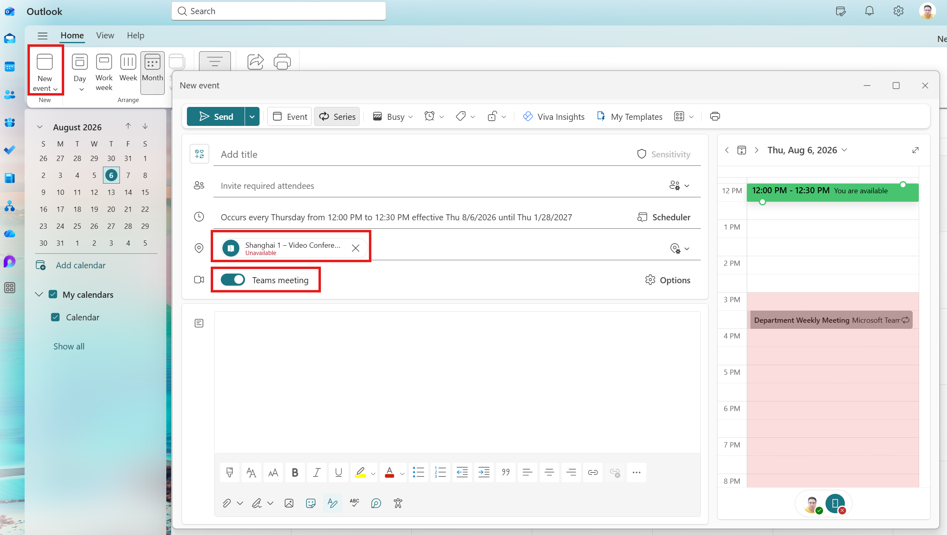
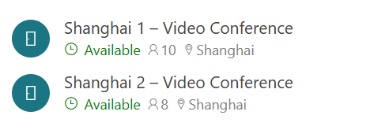
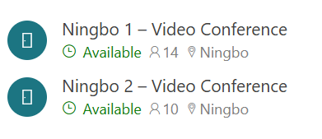
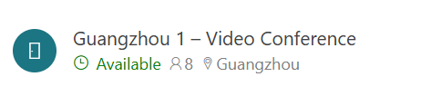
Book Meeting Room
Shanghai Office
Ningbo Office
Guangzhou Office

Slide 13
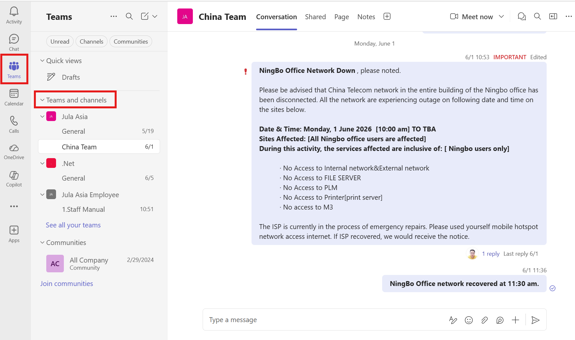
Teams Channels
Important IT notifications will be posted in Teams Channels. Please be sure to check them.

Slide 14
Basic IT Policy in Jula
Company‑owned computers must not install or store any unauthorized software.
公司电脑不得安装或存储任何未经授权的软件
Company hardware and software resources shall not be used for purposes unrelated to business operations.
不得使用公司的软硬件资源于与公司业务无关的方面
Users are obligated to keep confidential all resources accessible under their permissions and must not share them without authorization.
用户对权限内可访问的资源有保密义务，未得到授权，不得随意分享
Downloading large‑sized files over the corporate network is prohibited to prevent congestion on the corporate dedicated line.
禁止使用公司网络下载大型文件，避免引起公司专线网络拥堵
IT Policies issued via other channels (Teams Channels, company‑wide email announcements, etc.)
通过其它途径发布的IT Policy （Teams Channels, 全员邮件通告等）
Full details of the IT Policy can be found via the link.

Slide 15
Basic IT Policy in Jula - Case
A colleague urgently needs data stored in my folder. To avoid work delays, I may share my username and password with the colleague so they can retrieve the data.
同事紧急要数据，但是数据存放在我的资料夹里，我可以把我的用户名和密码给同事，让他拿到数据，避免耽误工作。
A poster requires adjustments. Contacting the vendor would be cumbersome, and Photoshop is not installed on my company‑owned PC. I therefore download and install a copy from the internet, and uninstall it the next day.
有个海报需要调整一下，但是联系供应商很麻烦，我的公司电脑又没有Photoshop软件，我就网上下载安装了一个，第二天就卸载了。
I travel frequently for business, often spending hours on the road. To pass the time, I install Storm Player to watch videos and TV series in my spare time.
经常出差，路上经常好几个小时，为了打发时间，我安装了暴风影音，有空看看视频和电视连续剧。
The company prohibits installing pirated software, yet the official software is expensive and my manager rejects the purchase request. I install the software on my personal home computer, finish the work, and email the output back to my company device for continued use.
公司提醒不让装盗版软件，软件又太贵，经理不批准购买，我就用家里的电脑安装了，处理完了，发邮件到公司里继续使用。
I have multiple large‑size important videos which cannot fit on my PC hard drive. If the laptop is lost, these files will disappear. I heard the corporate file server has permanent backup with large storage capacity. Storing these files on the company server would be the safest option.
有些很重要的视频太大，又多，电脑硬盘放不下，而且电脑万一丢了，文件就没了，听说公司的文件服务器是有备份的，永远不会丢数据，而且容量也大，把这些文件放在公司的服务器上最安全了。
I have heard that the corporate network uses an international dedicated line which can access overseas websites unavailable on home internet. I may leverage the company network to visit such websites regularly.
听说公司的网络是国外专线，可以翻墙看到很多国内看不到的信息，我可以多用公司的网络访问一些平时家里网络看不到的站点。

Slide 16

THANKS

